Slide 1


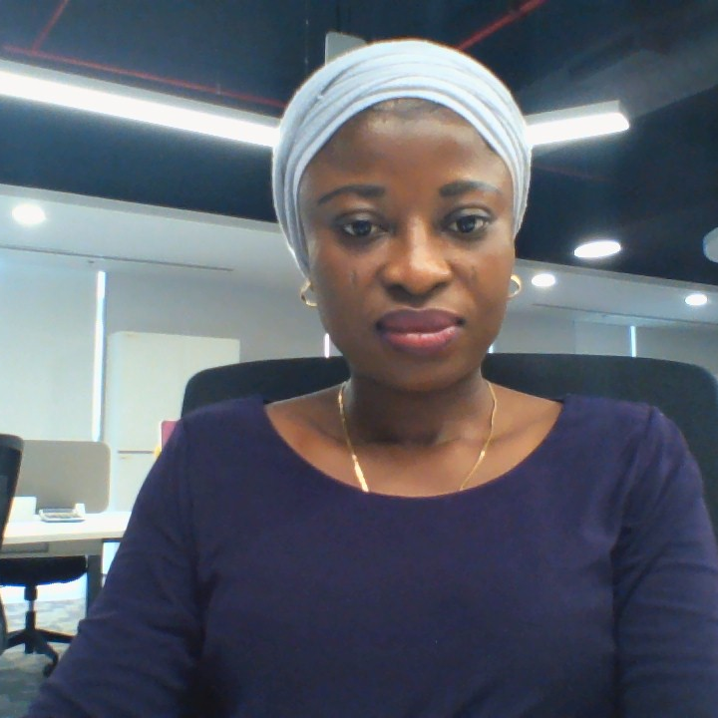
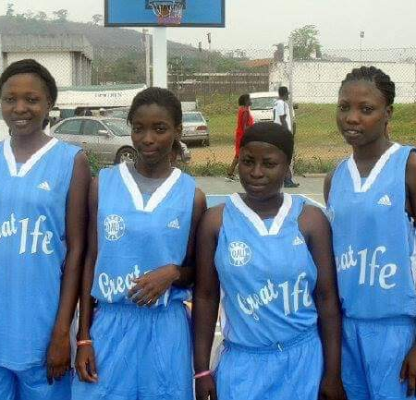
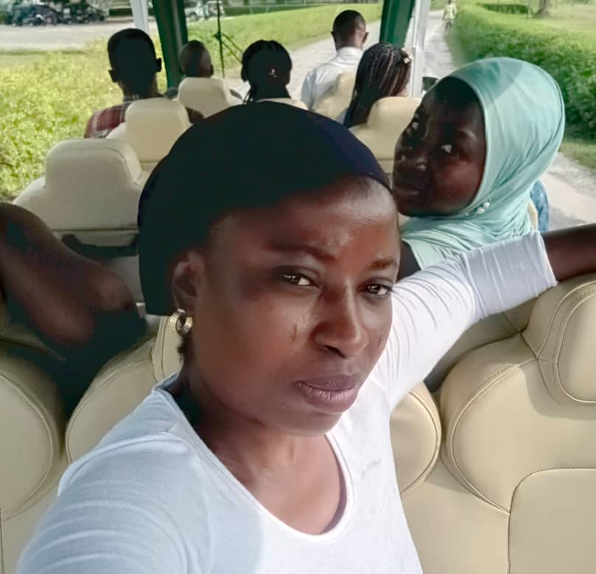
Getting to Know Me
Work
Personal
My role
Finance and Account Manager (Treasury Lead)
Significant others / family members / furry friends in my life
Family (Nuclear & Extended) and Friends
Tenure in ofi/Olam
8Years
How I enjoy spending my free time
Exercise, Sitting alone for self reflection, Hangout
Previous companies I have worked at
University Press Plc Jericho Oyo state Nigeria
My favorite / comfort food
Local Delicacy
Why I joined ofi/Olam and what keeps me here?
Strategically align financial acumen with corporate goals while gaining experience and exposure in a diverse and global work environment
Career growth enabling Environment
Work-life balance practice
Result and people oriented work space
My favorite song
TDetermined by my state of mind
Rukayat Olanrewaju
‘Rukayat’
I have always been a plus size person from childhood, I lost almost 30kg to achieve my current weight
This is me outside work, doing stuff I enjoy in my life …

